Slide 1
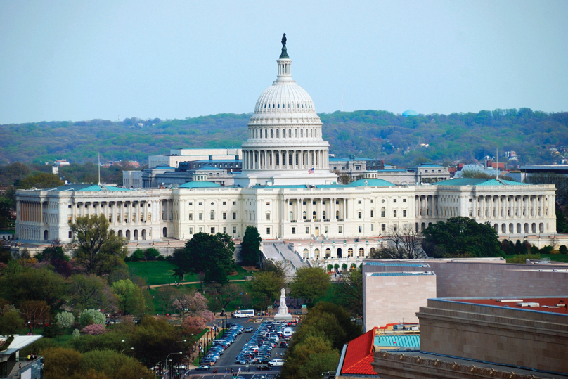
Chapter 15: Federal Budgets
Wayne Geerling
University of Texas

Slide 2
Big Questions
How does the government spend?
How does the government tax?
What are budget deficits?

Slide 3
Government Outlays and Revenue
Government spending vs. transfer payments
Spending: government buys goods or services
Transfer: money is moved from one group to another
Government revenues
Generally raised through taxes
Other small fees as well (national park admittance)

Slide 4
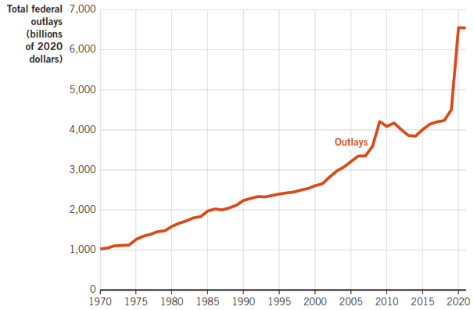
U.S. Government Outlays, 1970-2021

Slide 5
Major Categories of National Government Spending
Mandatory outlays
Determined by ongoing programs
Social Security, Medicare
Cannot be altered during the budget process
Altering requires long-run changes to existing laws
Discretionary outlays
Can be altered when the annual budget is set
Bridges, payments to government workers, defense spending

Slide 6
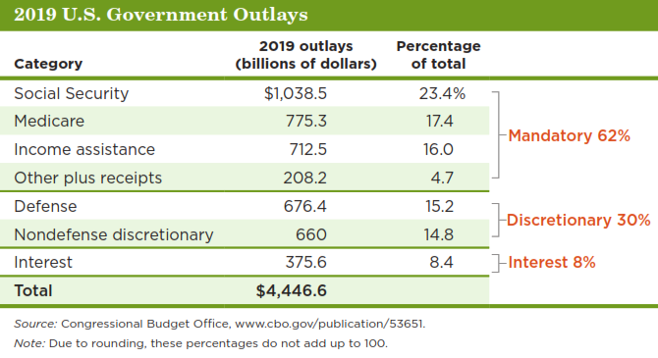
2019 U.S. Government Outlays

Slide 7
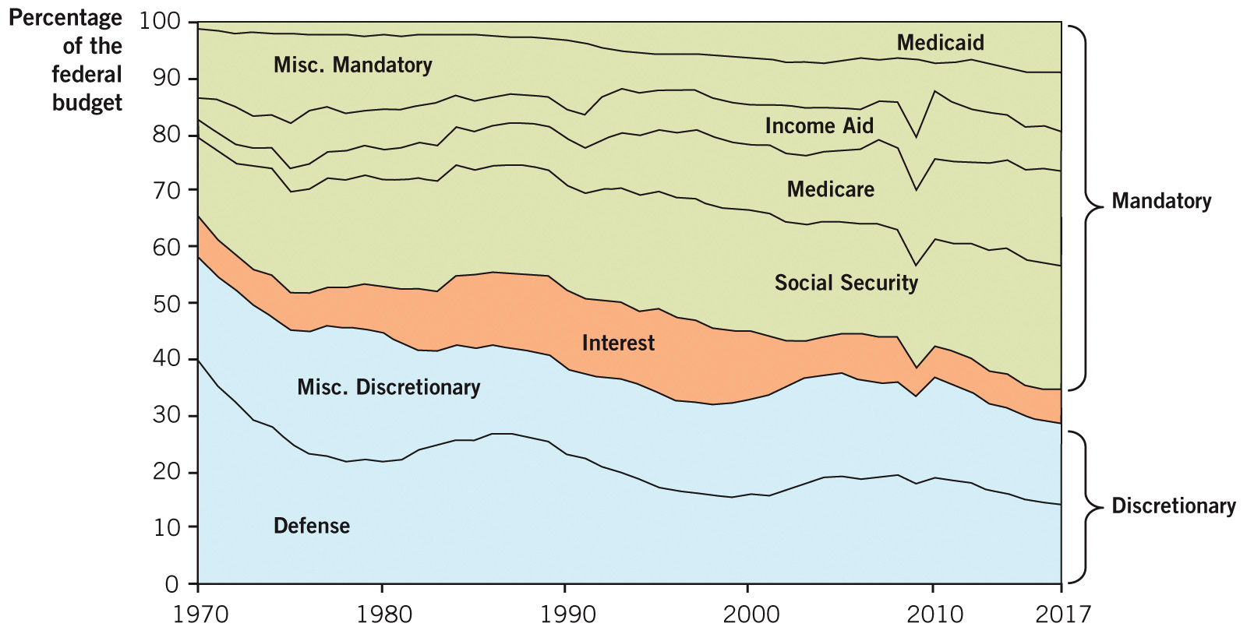
Historical Federal Outlay Shares, 1970-2017

Slide 8
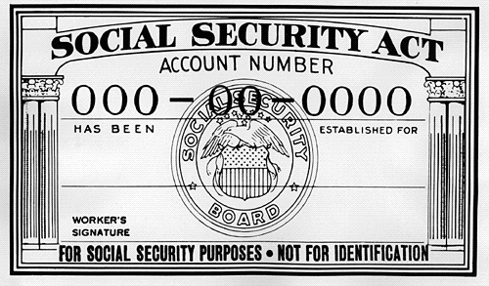
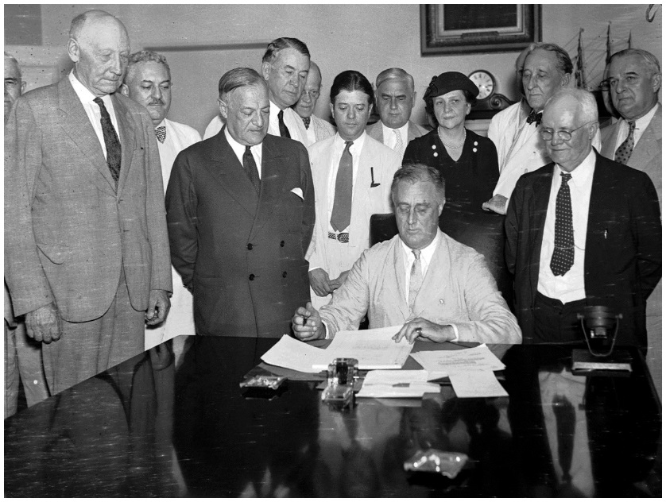
Social Security
Social Security
Requires workers to contribute a portion of their earnings to the Social Security Trust Fund
Goal:
Guarantee that no American worker retires without at least some retirement income

Slide 9

Medicare/Medicaid
Medicare
Federal program that funds health care for retirees. (Medicaid funds health care for those without jobs.)
Goal:
Ensure that all retired workers have some funding for their health care

Slide 10

Demographic Changes
Social Security & Medicare are taking an ever-growing share of the federal budget.
3 main demographic reasons:
People are living longer.
There are now far more workers retired & drawing benefits than before.
The baby-boom generation are now retiring. The oldest boomers reached 65 years old in 2011.

Slide 11
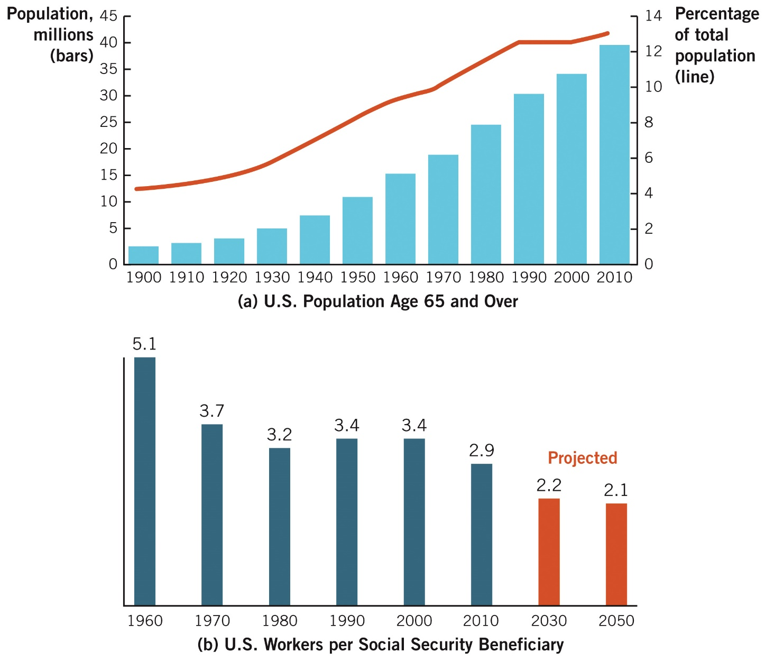
Aging Population, Fewer Workers, More Beneficiaries

Slide 12
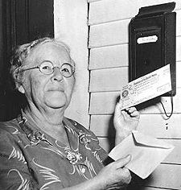
The First Recipient
Ida May Fuller.
Received check 00-000-001 in January 1940.
Taxes and outlays
Ida May Fuller worked for three years under the program, and was taxed a total of $24.75
She lived to be 100 years old & collected a total of $22,888.92 from the program!

Slide 13

The Social Security Time Bomb

Slide 14
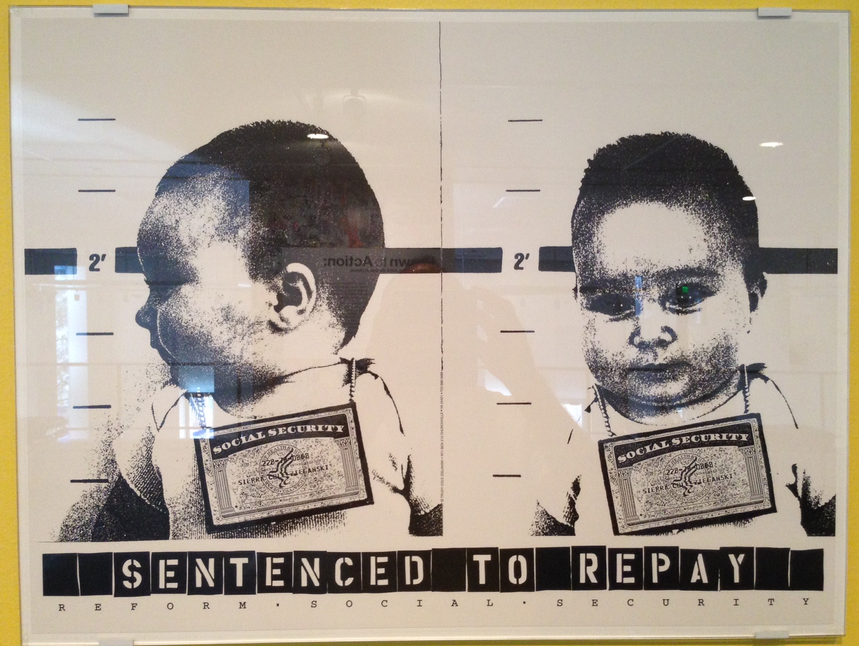
Sentenced to Repay

Slide 15

Are There Simple Fixes to the Social Security & Medicare Funding Problems?
1. Increase retirement age from 67 to 70.
2. Adjust benefits computation using the CPI instead of average wage levels.
3. Means-test for benefits.

Slide 16
Current Fiscal Issues
Three major factors that have contributed to the increase in spending have been:
1. 1990-2008: relative economic stability that required very little fiscal policy response.
2. 2008-2020: huge increase in outlays was a direct response to the Great Recession. Period followed by more than 10 years of economic expansion.
3. 2020-22: COVID-19 recession caused by global pandemic. Massive rise in government spending.

Slide 17
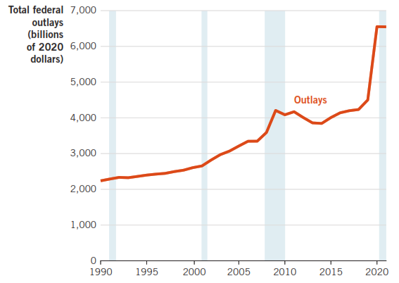
U.S. Government Outlays 1990–2021

Slide 18
Government Revenue
Two largest sources of government revenue are individual income taxes & social insurance.
Combined they make up more than 80% of all federal tax revenue
Other tax revenue sources
Corporate, estate and gift, excise, and custom taxes

Slide 19
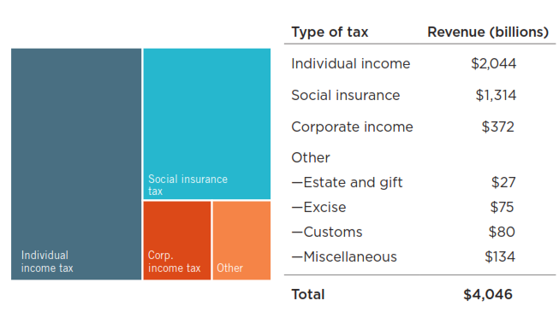
U.S. Federal Tax Revenue Sources, 2021

Slide 20
Budget Deficit and Budget Surplus
Budget deficit
Occurs when government outlays exceeds revenue in a given time period, usually a year.
Outlays > revenues.
More funds flowing out than in.
Budget surplus
Occurs when government revenue exceeds outlays in a given time period, usually a year.
Revenues > outlays.
More funds flowing in than out.

Slide 21
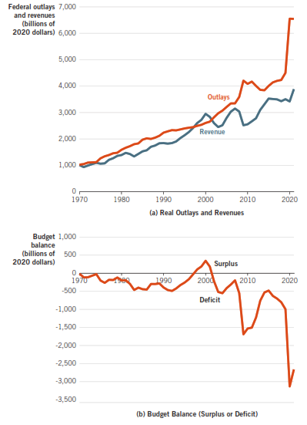
U.S. Federal Budget Data, 1970-2021

Slide 22
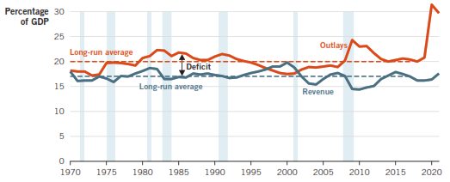
U.S. Federal Outlays and Revenue as a Portion of GDP, 1970-2021

Slide 23

Deficit
Debt

Slide 24
Deficits versus Debt
Deficit ≠ debt
Deficit: outlays > revenue
National debt: total funds borrowed by the government
The national debt
Part is owed to the public
Part is owed to government agencies

Slide 25
US Debt Clock

Slide 26
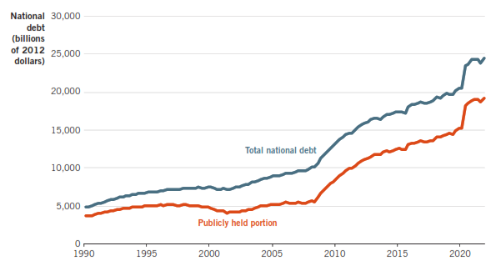
U.S. National Debt, 1990–2021

Slide 27
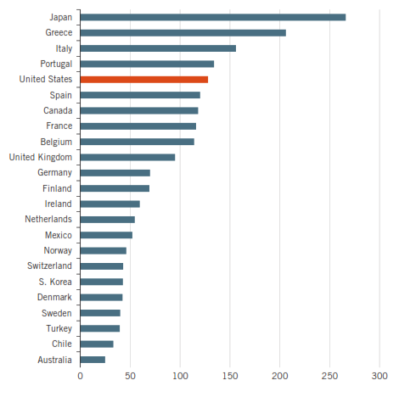
International Debt-to-GDP Ratios, 2020

Slide 28
Foreign Ownership of U.S. Debt
There has been public concern over international ownership of U.S. debt, but:
70% of national debt is held domestically.
30% is held internationally.
Foreign lending increases the supply of loanable funds.
Decreases interest rates.

Slide 29
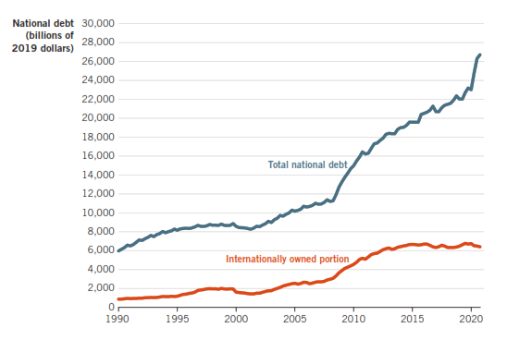
Foreign & Domestic Ownership of U.S. Debt

Slide 30

A Demonstration
Blow up the balloons in small puffs.
Compare the National Debt with the size of the U.S. economy.
Keep blowing the balloons until they are really full.
How can the balloons be deflated?
Notes:
Tip 565

Slide 31

Can the U.S. Government Go Bankrupt?
Refinance the debt
Increases taxes
Print more money

